Slide 1
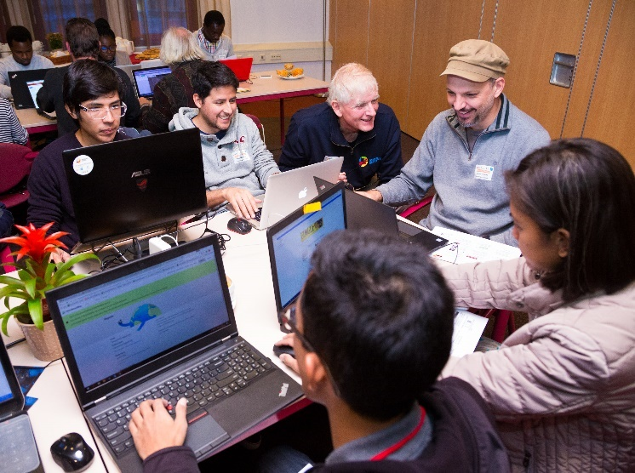
Crowdsourcing in National Mapping 2017
An International Workshop
Leuven, Belgium April 3rd and 4th 2017
Hackathon Challenge Introduction
Rob Lemmens
University of Twente
Faculty of Geo-Information Science and Earth Observation (ITC)
Enschede,
The Netherlands
r.l.g.Lemmens@utwente.nl
Notes:
… we need standards describing the service interfaces and data encoding

Slide 2
Marathons of development
Hackathon: An event in which software developers and subject-matter-experts collaborate intensively on a software project.
  Creating new software
  Combining existing software
Datathon: An event to add value to data by processing it with existing software.
Mapathon: An event to improve map data

Slide 3
Ingredients of a hackathon
Objective
Planning: 1 event (1-2 days), Split event (Call-Development-Presentation)
Software developers, subject-matter-experts
Incentives: Learning, Prizes
Challenges: Feasible tasks as part of overall plan and follow-up work
  May vary from general proof-of-concept to specific development

Slide 4
Hackathon examples

Slide 5
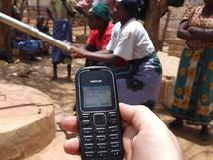
Project Human Sensor Web
(Zanzibar-Tanzania)
Billboard at water tap
Text messages on water availability

Slide 6
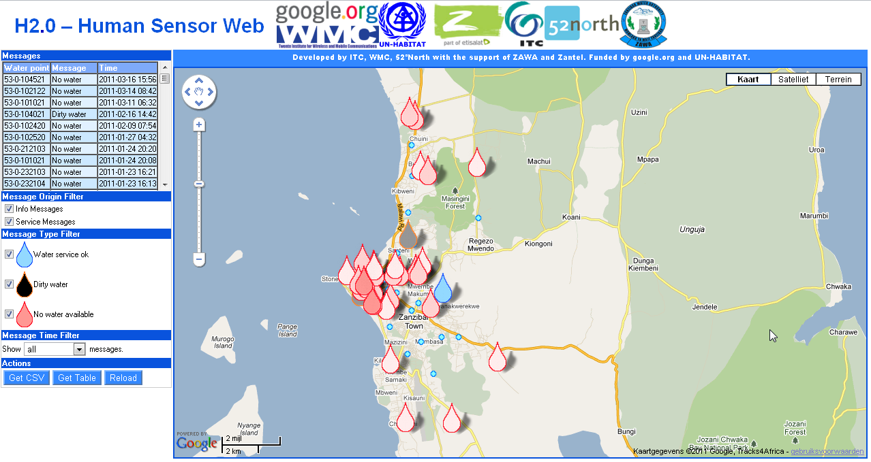
Human Sensor Web
End user application

Slide 7
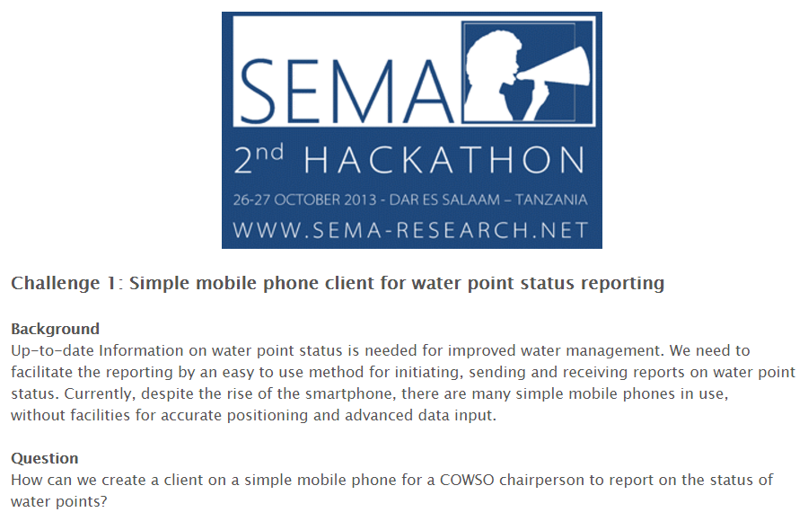
Challenges

Slide 8
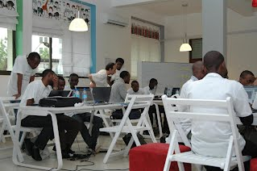
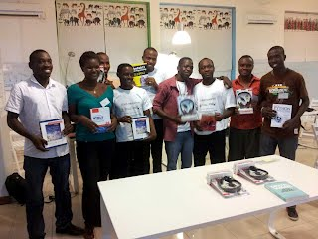
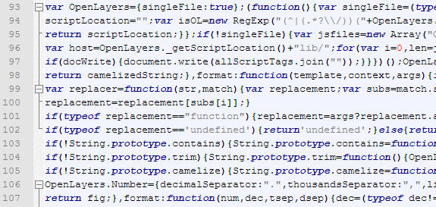
Hackathon Tanzania
Challenges:
1 Input: USSD App
2 Input: Android App
3 Interoperability
4 Output: Ontology-based Web
5 Output: Android App

Slide 9
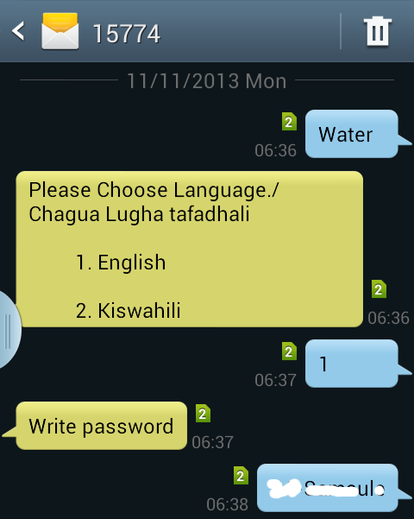
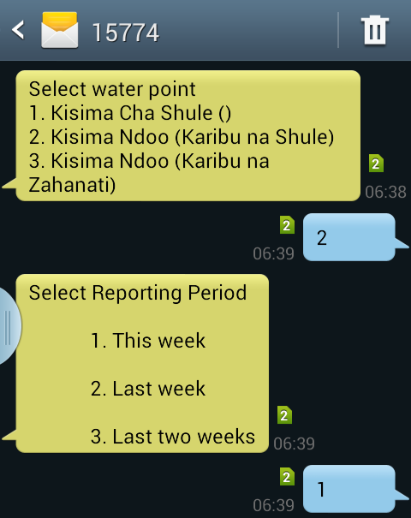
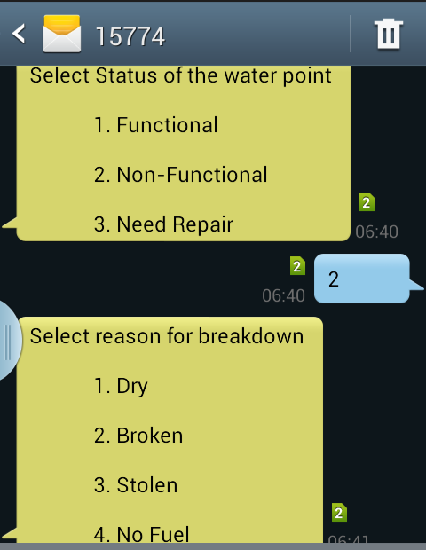
Mobile App for reporting on water point status

Slide 10
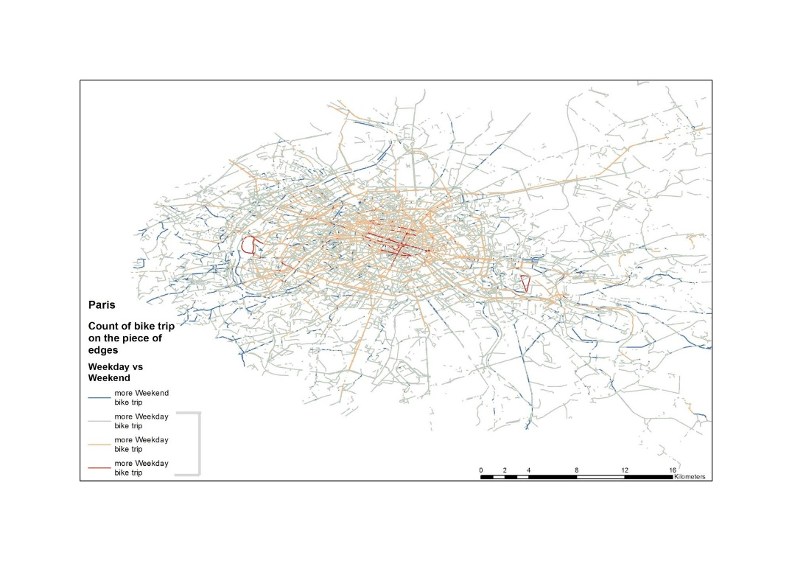
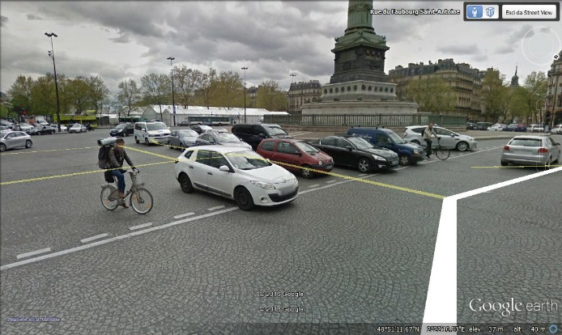
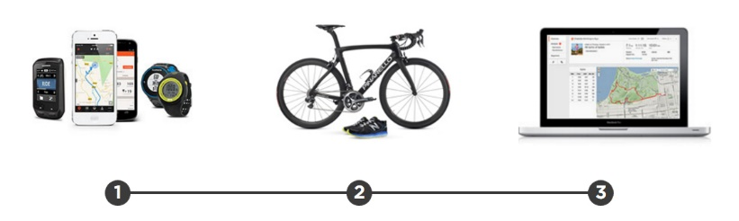
Datathon COST ENERGIC Project
Cycling the city – Paris
TEAM: Antonello Romano, Stefano Picascia, Cristina Capineri, Michela Teobaldi. LADEST LAB. - University of Siena
Background: Catchment area of public transport can be increased by using bike as first part of trip.
Objective: Use VGI to detect relevant cycling paths (recorded by cyclists).

Slide 11

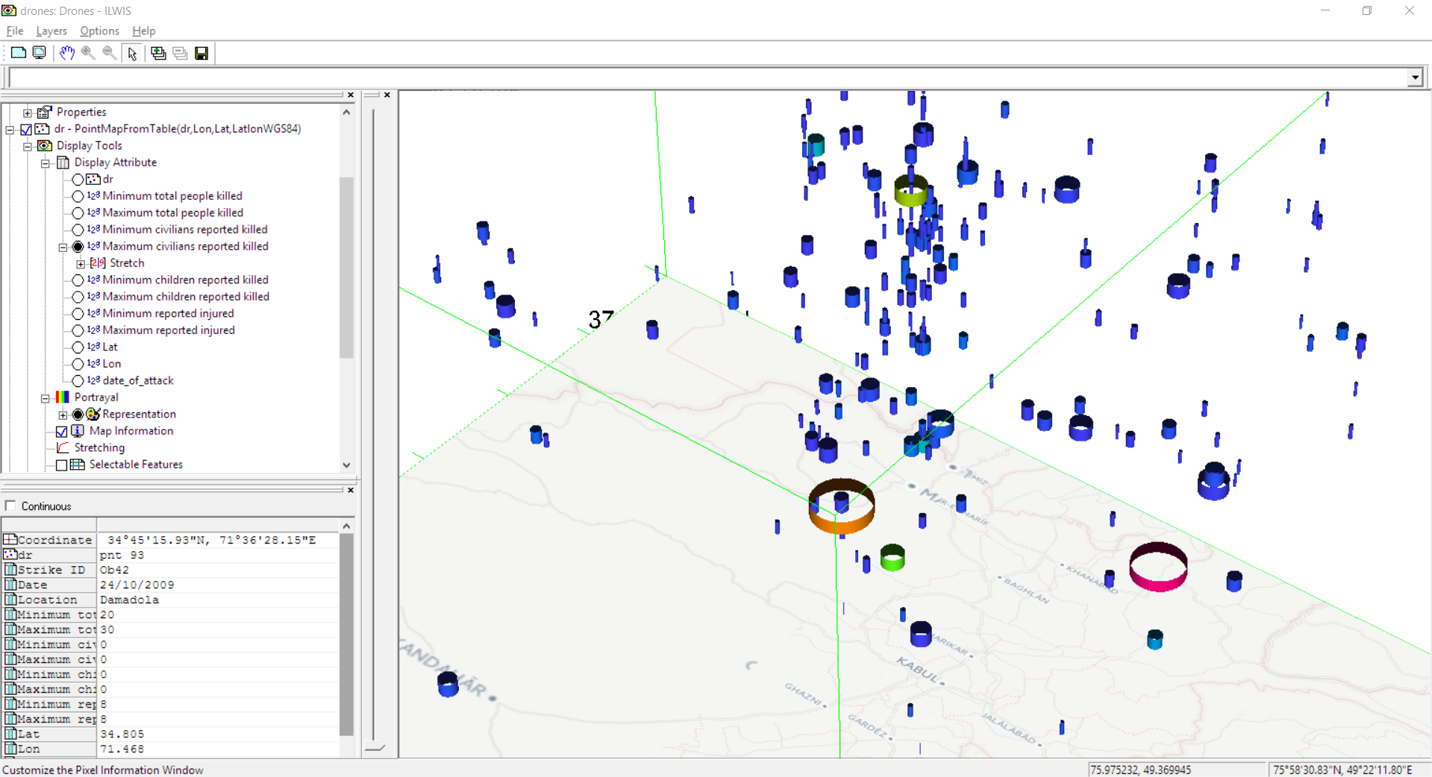



Combining data and software
App using Linked Data visualizer and Space-Time-Cube
Ob21

Slide 12
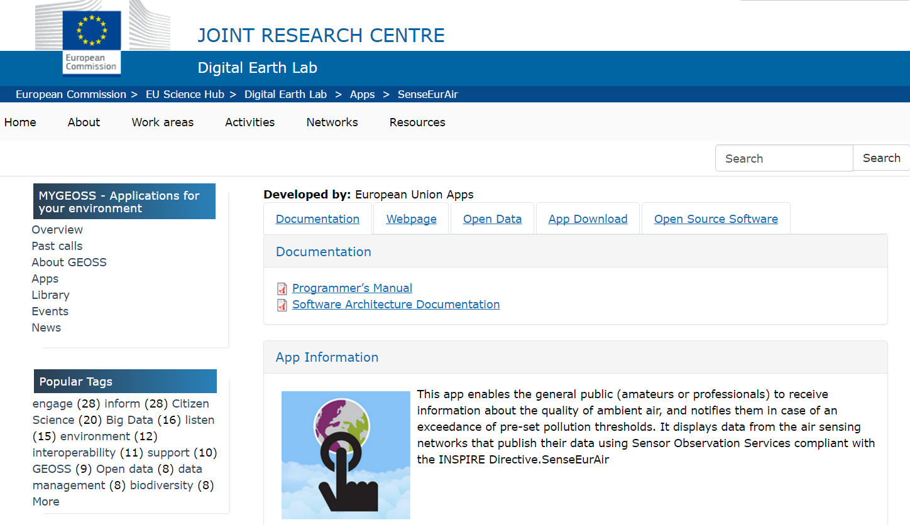
App development – JRC Digital Earth Lab

Slide 13
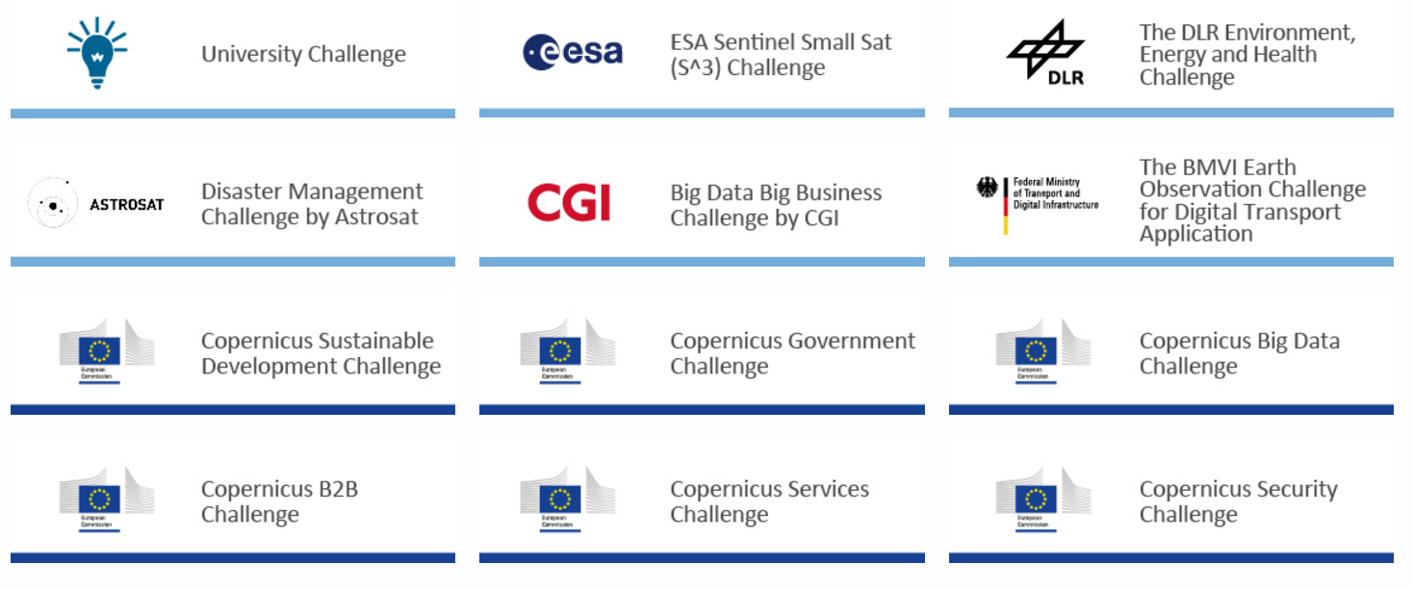
EU Copernicus Masters

Slide 14

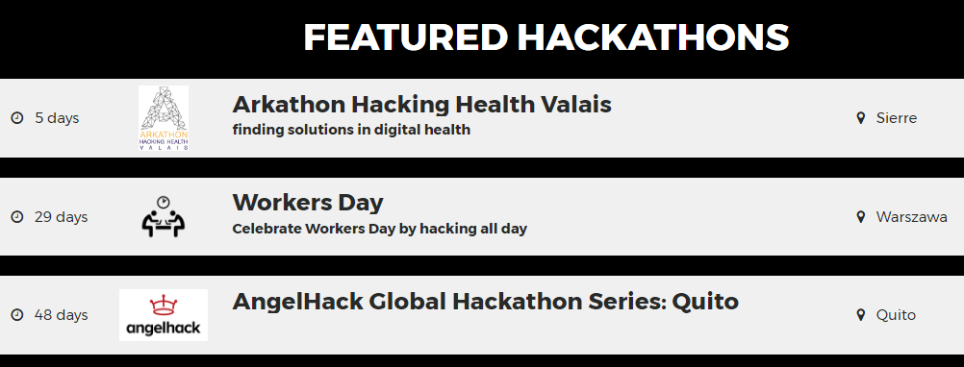
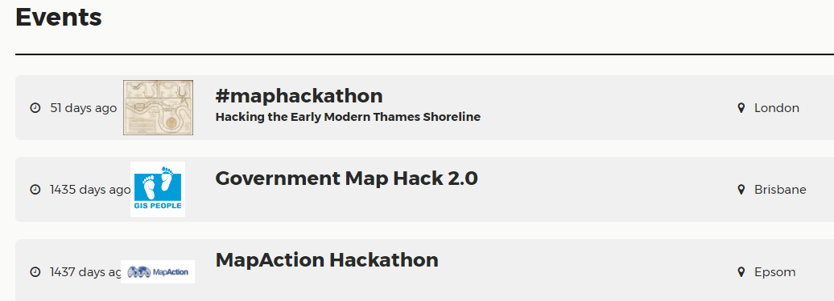
Lots on health, government, … and little on maps…

Slide 15
Challenge examples for
Mapping and Cadastral Agencies

Slide 16
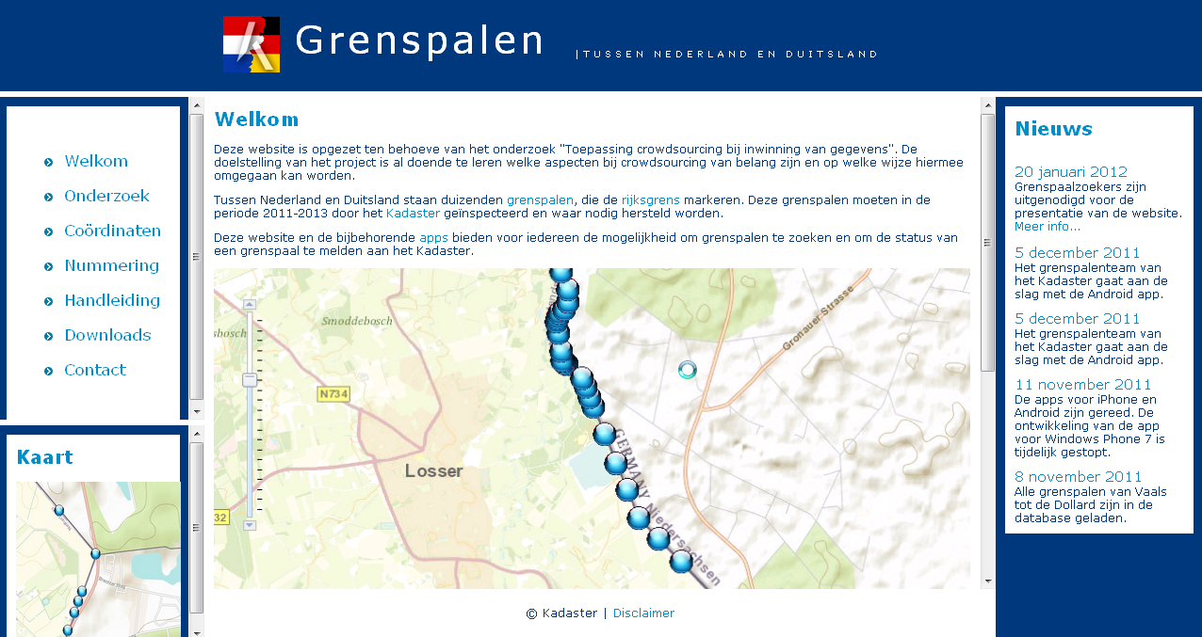
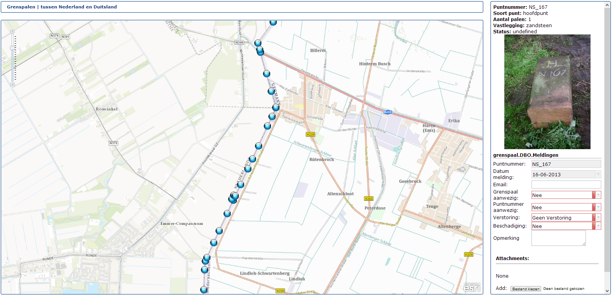
Dutch Cadastre – Boundary stones pilot

Slide 17
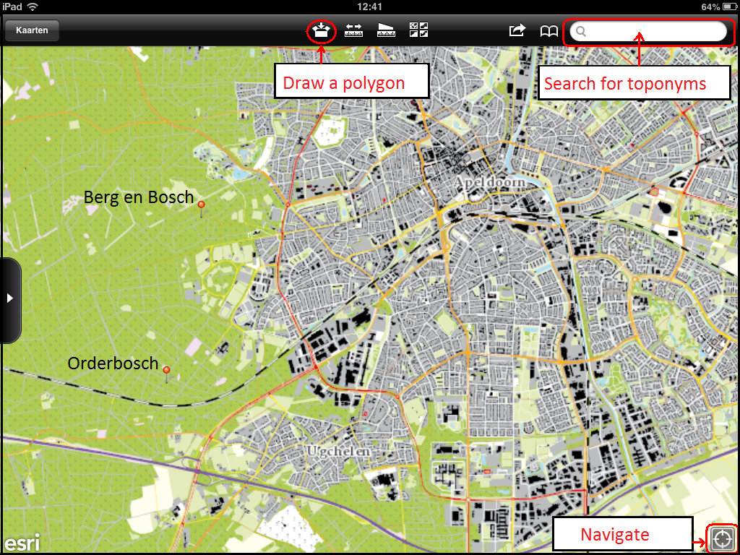
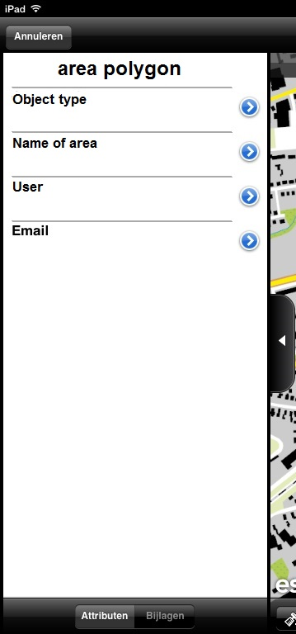


VGI Application for toponymic data

Slide 18
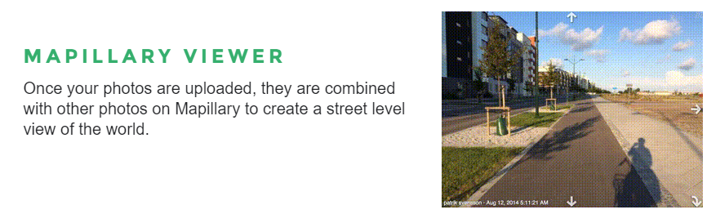
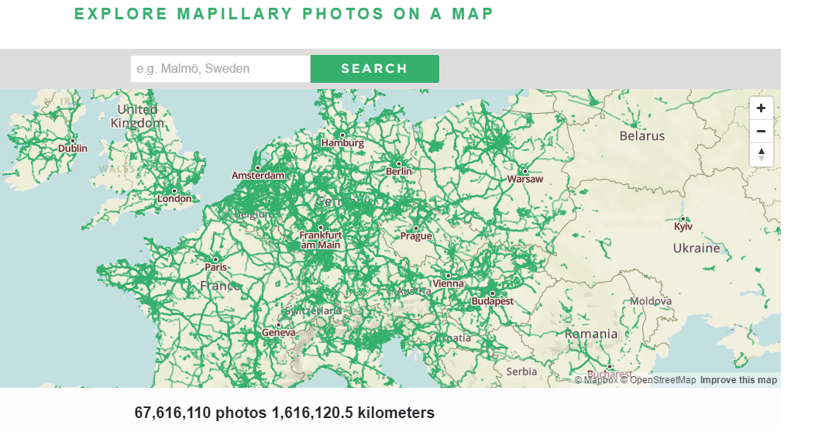
Mapillary Street Photos

Slide 19
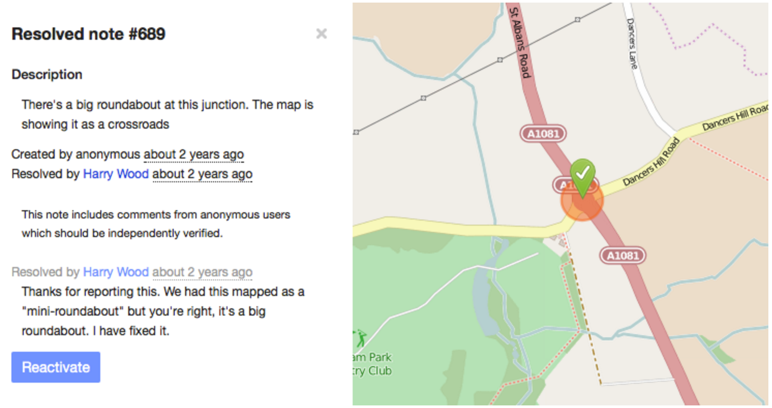
OpenStreetMap Notes

Slide 20
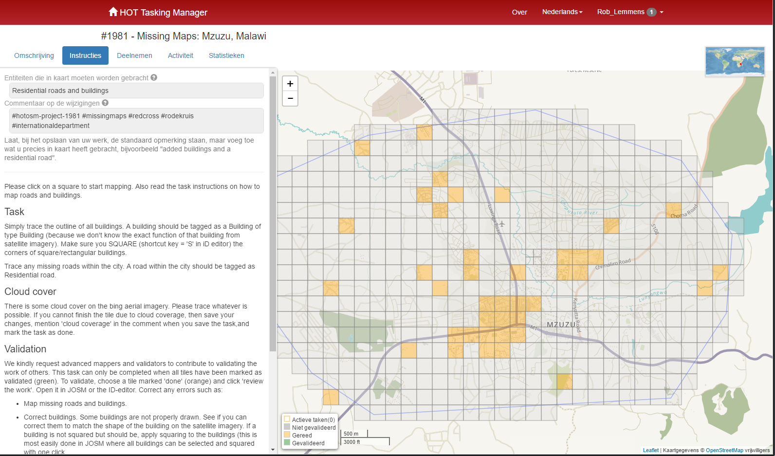
OpenStreetMap Tasking Manager

Slide 21
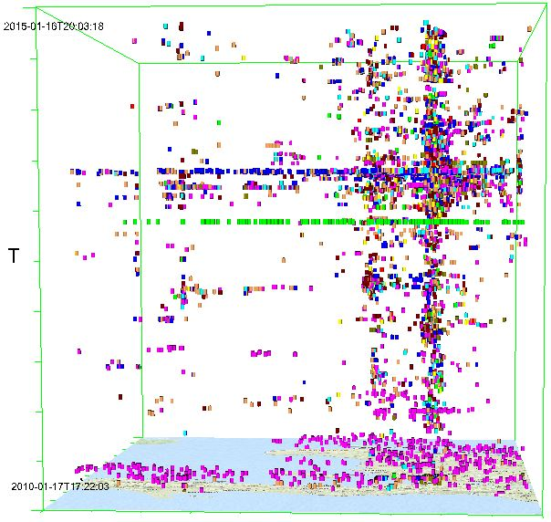
OpenStreetMap edits in Space-Time-Cube
Haiti region

Slide 22
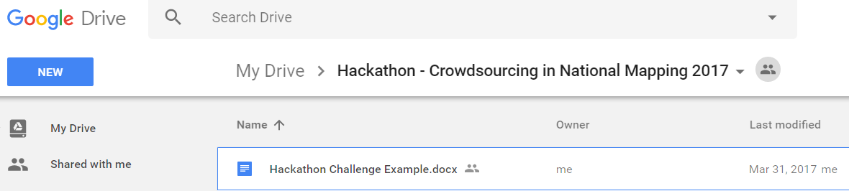
Hackathon – Creation of challenges
Title
Authors
Background and problem
Objective
Data needed
Intended users
Software guidelines
Incentives for hackathon participants (Learning, Prize)

Slide 23





Hackathon – Creation of challenges
I know about:
Mapping and Cadastral
agency
processes
Application development
Other
Crowdsourcing
Your name
Your name
Your name
Your name

Slide 24
Hackathon – timing
20 April 2017 Workshop Leuven: First ideas on challenges and discussion on mode of operation
May 2017: Circulation of workshop report to NMCAs, invitation of additional ideas
June 2017: Call for Hackathon
Sept 2017: Selection of winning team(s)
Oct/Nov/Dec 2017: Presentation of results at EuroSDR meeting

Slide 25
Expected hackathon output
A short report containing:
  General working of your application
  Justification of the originality and novelty of your approach
  A description of the data and methods and external sources you used (with links to these such that your work can be reproduced)
  An explanation of the obstacles encountered in carrying out the hackathon, recommendations for further work.
A 2 minute video pitch presenting your application

Slide 26
Judging criteria
Overall quality of the entry to the hackathon
Originality and novelty of the approach taken
Quality of the description of the data and tools used, especially with respect to reproducibility
Soundness of the approach taken
Potential scientific, societal and policy impacts of the results
Quality and engagement in the video pitch

Slide 27
